Slide 1


Vilnius, Lithuania
Monday, July 9, 2018

Slide 2
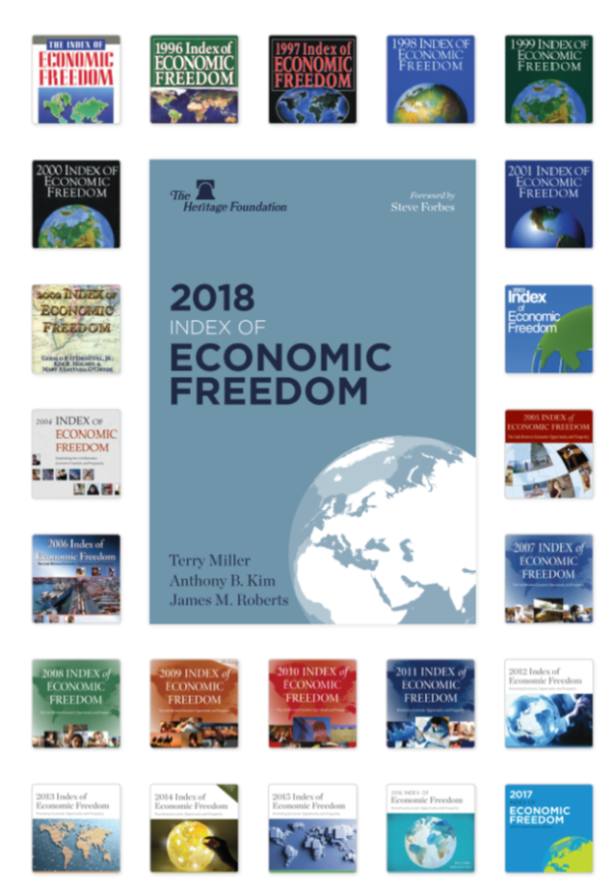
Building an America
Where Freedom,
Opportunity,
Prosperity, and
Civil Society Flourish

Slide 3

Four Pillars of Economic Freedom
Rule of Law
Fiscal Health
Gov’t Spending
Government Integrity
Property Rights
Judicial Effectiveness
Government Size
Tax Burden
Regulatory Efficiency
Open Markets
Business Freedom
Labor Freedom
Monetary Freedom
Trade Freedom
Investment Freedom
Financial Freedom

Slide 4
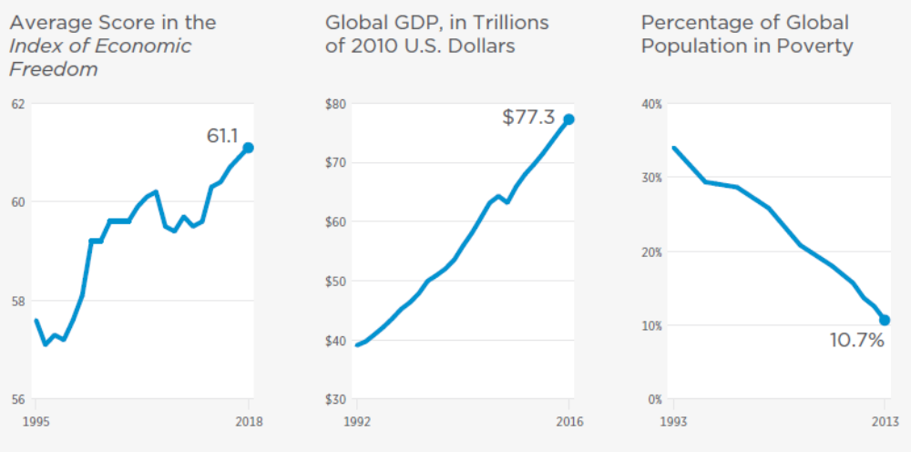
As Economic Freedom Rises,
The Global Economy Expands and Poverty Falls

Slide 5
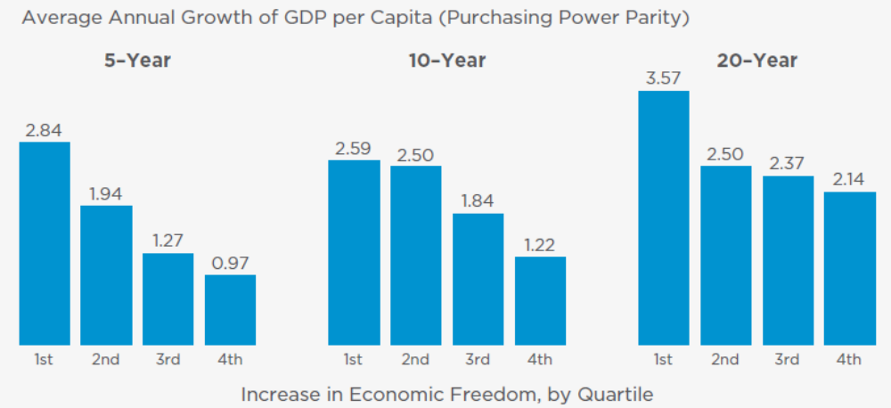
With Economic Freedom Comes
More Vibrant Growth

Slide 6
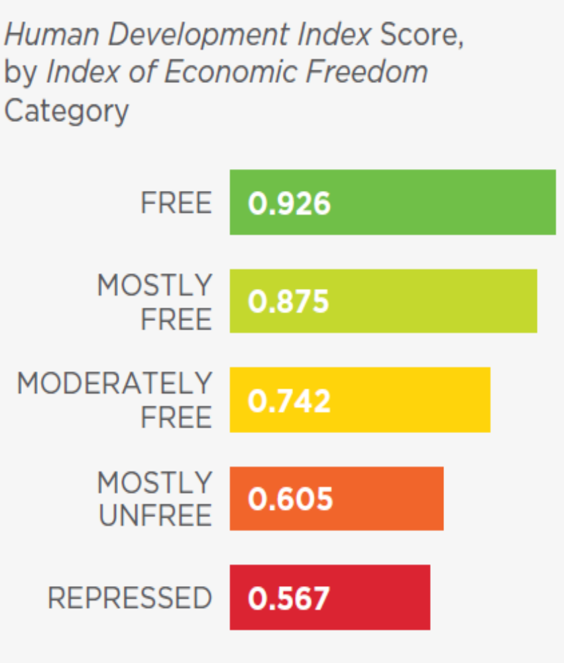
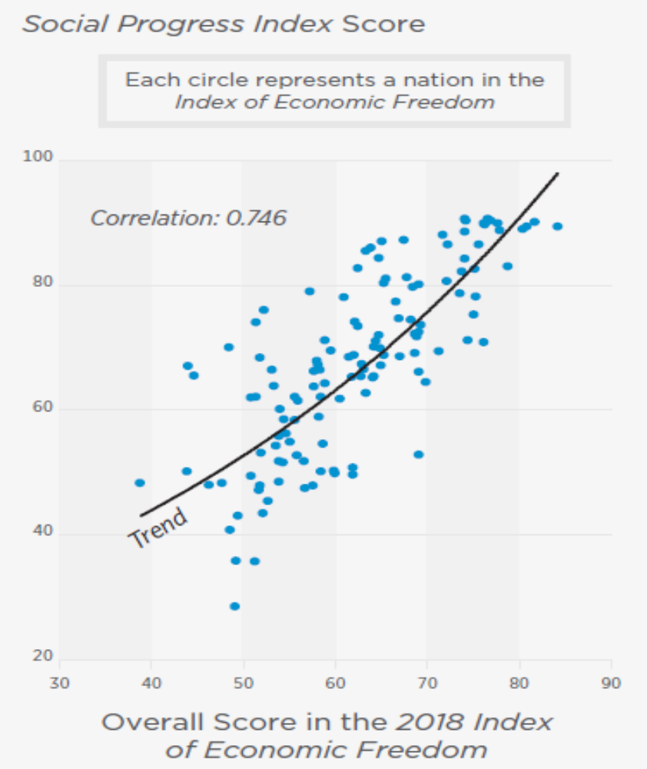
Economic Freedom:
Key to Human Development and Social Progress

Slide 7
Greater Economic Freedom, Greater Prosperity

Slide 8

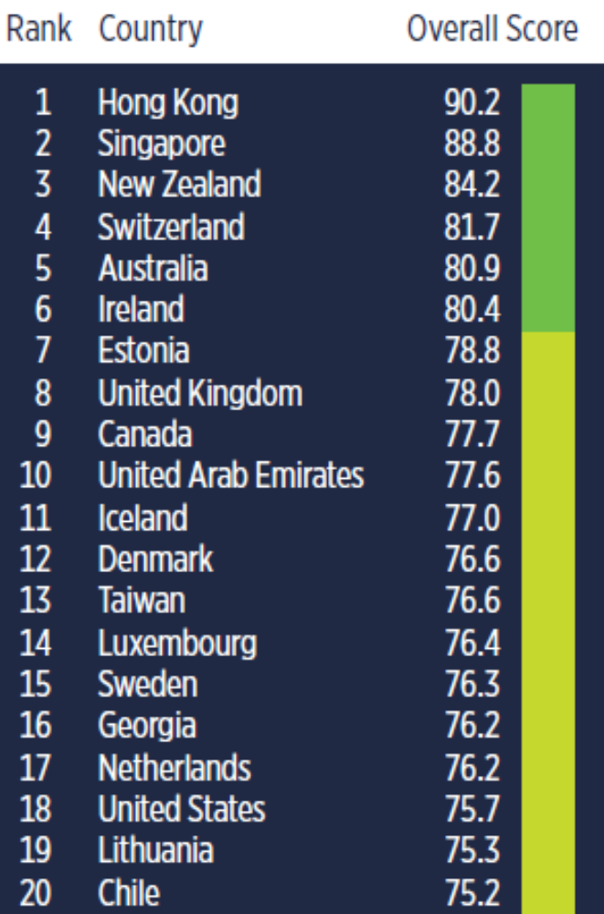
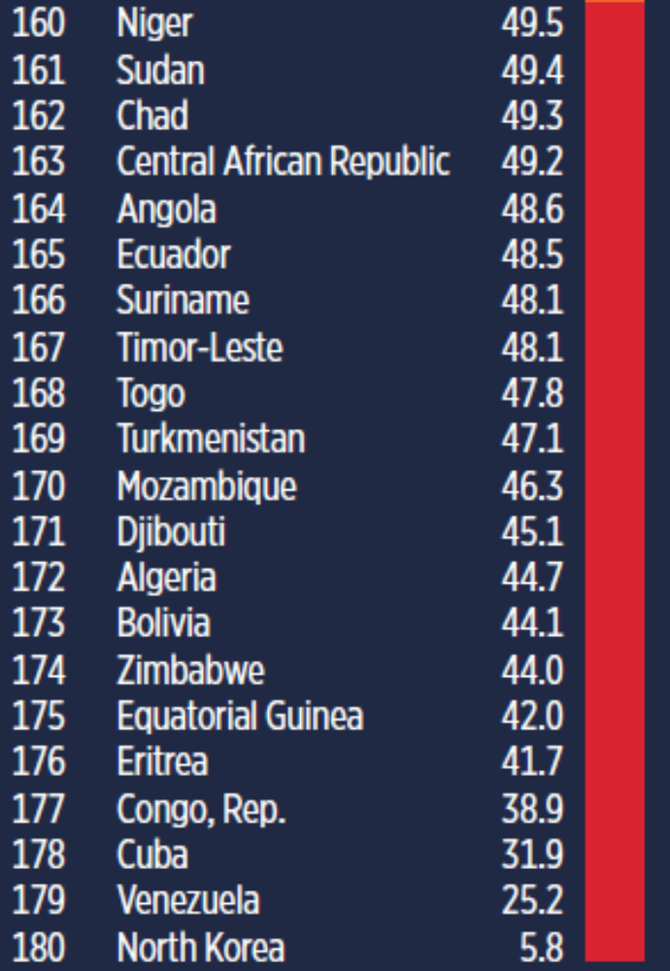
Top 20 vs. Bottom 20

Slide 9
Lithuania’s Rising Economic Freedom Since 1996

Slide 10
Lithuania vs. The World Average

Slide 11
Lithuania vs. Europe

Slide 12
Lithuania vs. EU

Slide 13
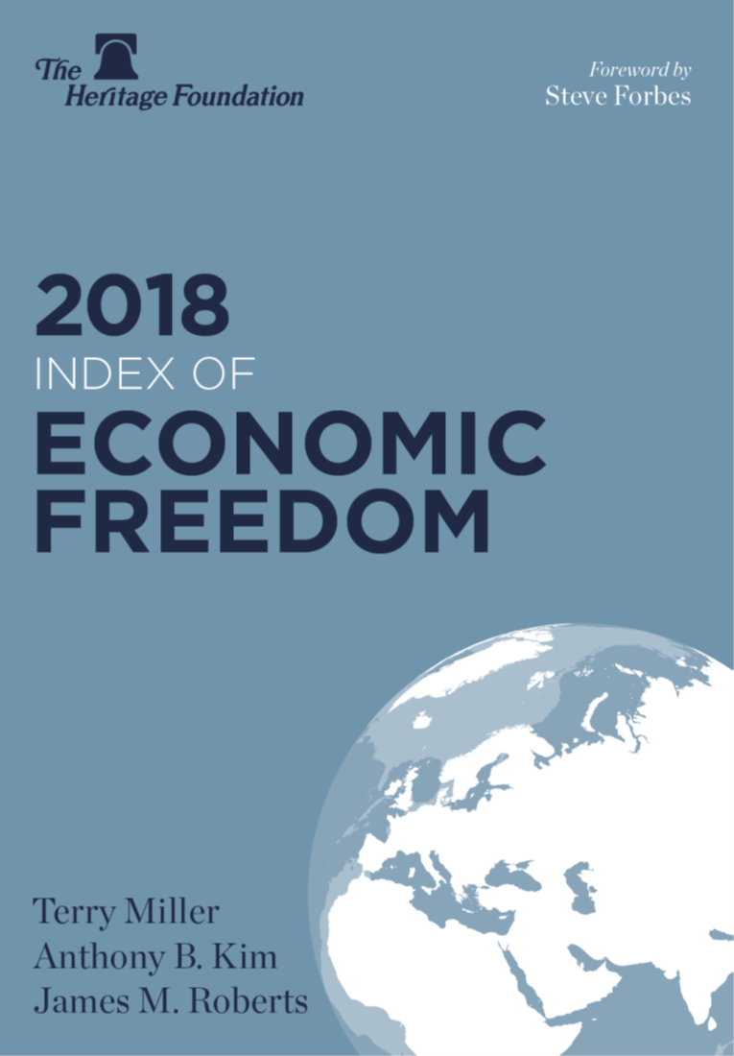

What’s Next for Lithuania?
Toward
Greater
Economic Dynamism
&
Prosperity

Slide 14
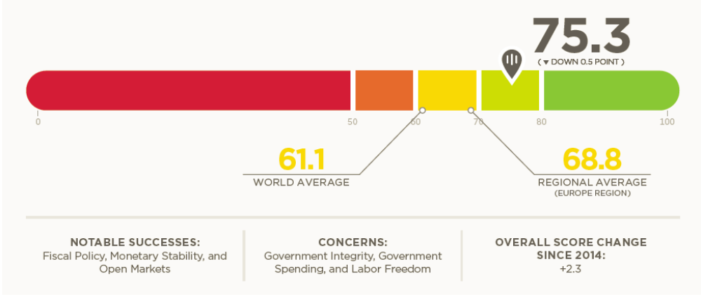
Economic Freedom in Lithuania

Slide 15
Lithuania vs. the U.S.

Slide 16
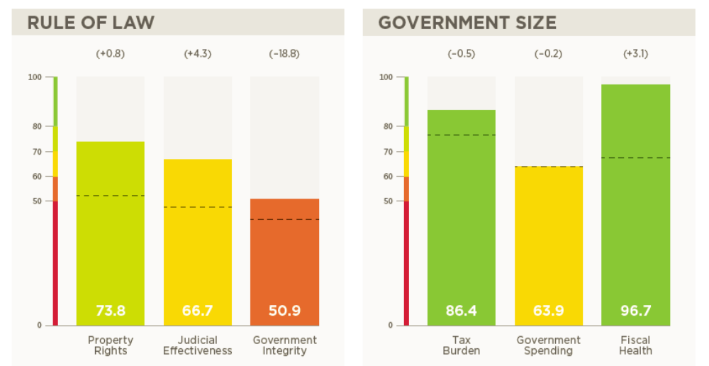
12 Economic Freedoms in Lithuania

Slide 17
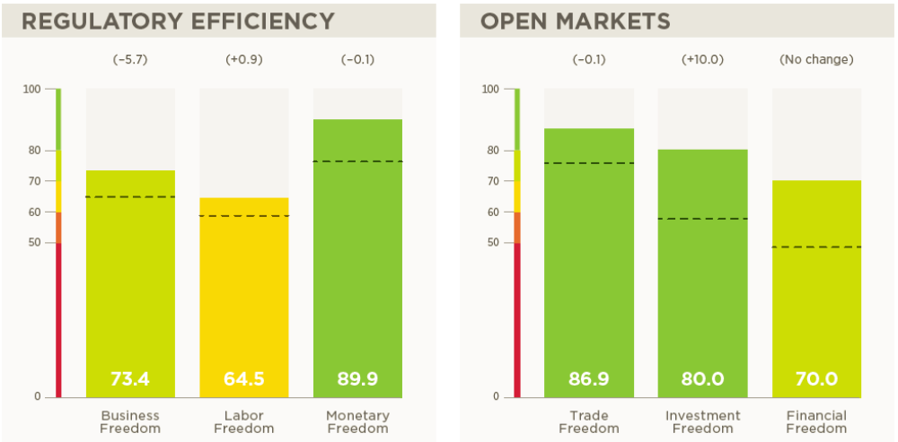
12 Economic Freedoms in Lithuania

Slide 18
Government Integrity
 | Lithuania | Ireland
Index Factor: Government Integrity Score | 50.9 | 79.0
Public Trust | 3.1 | 4.9
Irregular Payments | 4.9 | 6.4
Government Transparency | 4.3 | 5.8
Corruption Perception | 59.0 | 73.0

Slide 19
Taxation
 | Lithuania | Ireland
Index Factor: Tax Burden Score | 86.4 | 76.1
Top Personal Tax Rate | 15.0% | 41.0%
Top Corporate Tax Rate | 15.0% | 12.5%
Tax Burden | 30.1% of GDP | 23.6% of GDP

Slide 20
Business Freedom
 | Lithuania | Ireland
Index Factor: Business Freedom Score | 73.4 | 81.8
Minimum Capital Requirement | 20.3% of income per capita | 0.0
Years Required in Closing a Business | 2.3 | 0.0
Number of Procedures to Incorporate | 4 | 3

Slide 21
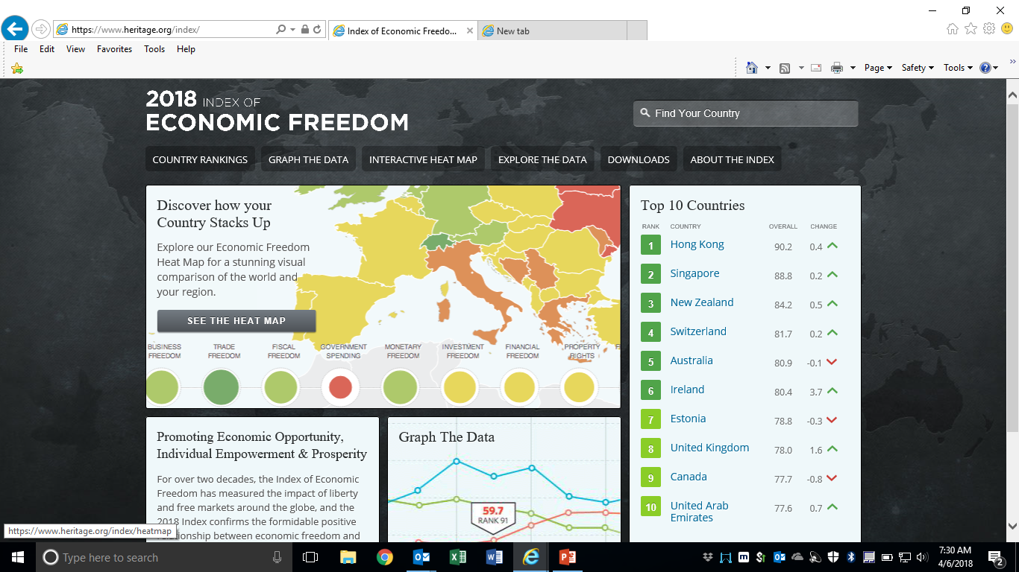
Visit www.heritage.org/index for More Information

